Slide 1
Multi-Omics Integration using OmicsNet
Metabolomics 2019
Guangyan Zhou (Guangyan.zhou@mail.mcgill.ca)
June 23, 2019

Slide 2
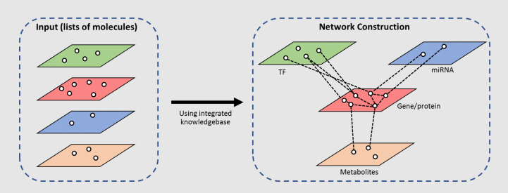
OmicsNet
OmicsNet (https://www.omicsnet.ca/) supports 3D network visualization and integration of multiple types of molecular interactions:
Conventional networks: protein-protein, TF-gene, miRNA-gene, enzyme-metabolite
Composite networks: OmicsNet constructs composite networks encompassing >1 interaction type

Slide 3
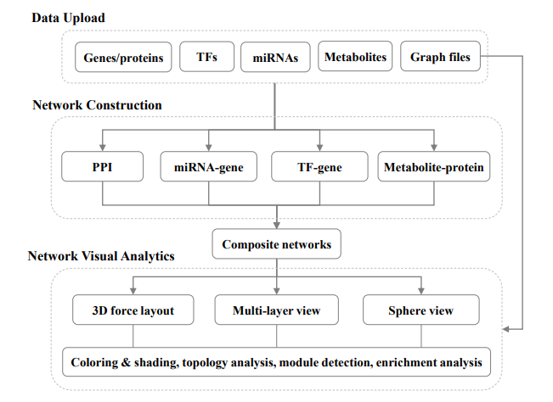
OmicsNet workflow

Slide 4
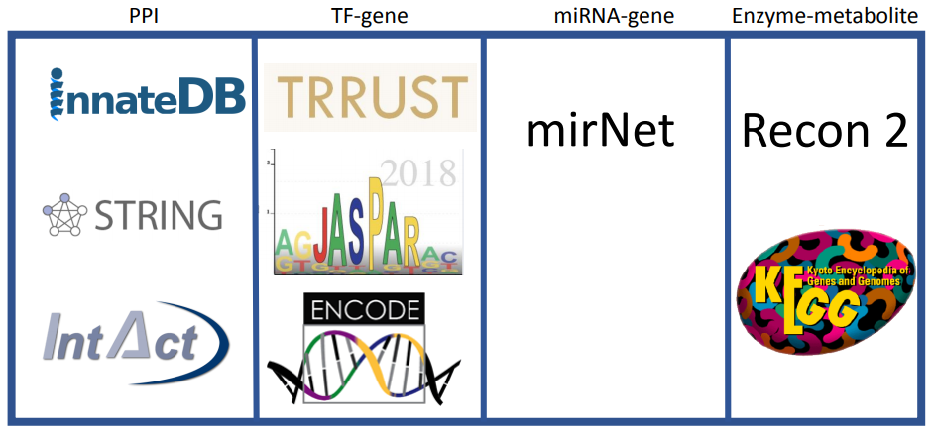
OmicsNet underlying knowledgebase
Built-in knowledgebase for network construction
Protein-protein interaction
Transcription factor-gene regulation
miRNA-gene regulation
Metabolite-protein interaction

Slide 5
Network building
1. For this tutorial, network building starts by uploading a list of genes and metabolites.
List of metabolites
Input
List of genes/proteins
Protein-protein interaction
Metabolite-enzyme interaction

Slide 6
Network building
2. Proteins that interact (yellow) with uploaded genes/proteins (blue, “seed proteins”) are added to the network.
List of metabolites
Input
List of genes/proteins
Protein-protein interaction
Metabolite-enzyme interaction

Slide 7
Network building
3. Metabolites (purple) that interact with the seed and/or interacting proteins are added to make up the final composite network.
List of metabolites
Input
List of genes/proteins
Protein-protein interaction
Metabolite-enzyme interaction

Slide 8

Data
67 human breast tumors and 65 tumor-adjacent noncancerous tissue samples from a study of the onset of breast cancer.
Untargeted metabolomics (Metabolon) of 352 known metabolites and microarrary analysis (Affymetrix Human Gene 1.0 ST Array) of tissue samples.
Download the “breast_cancer.zip” zipped folder from the tutorials page of OmicsNet.

Slide 9
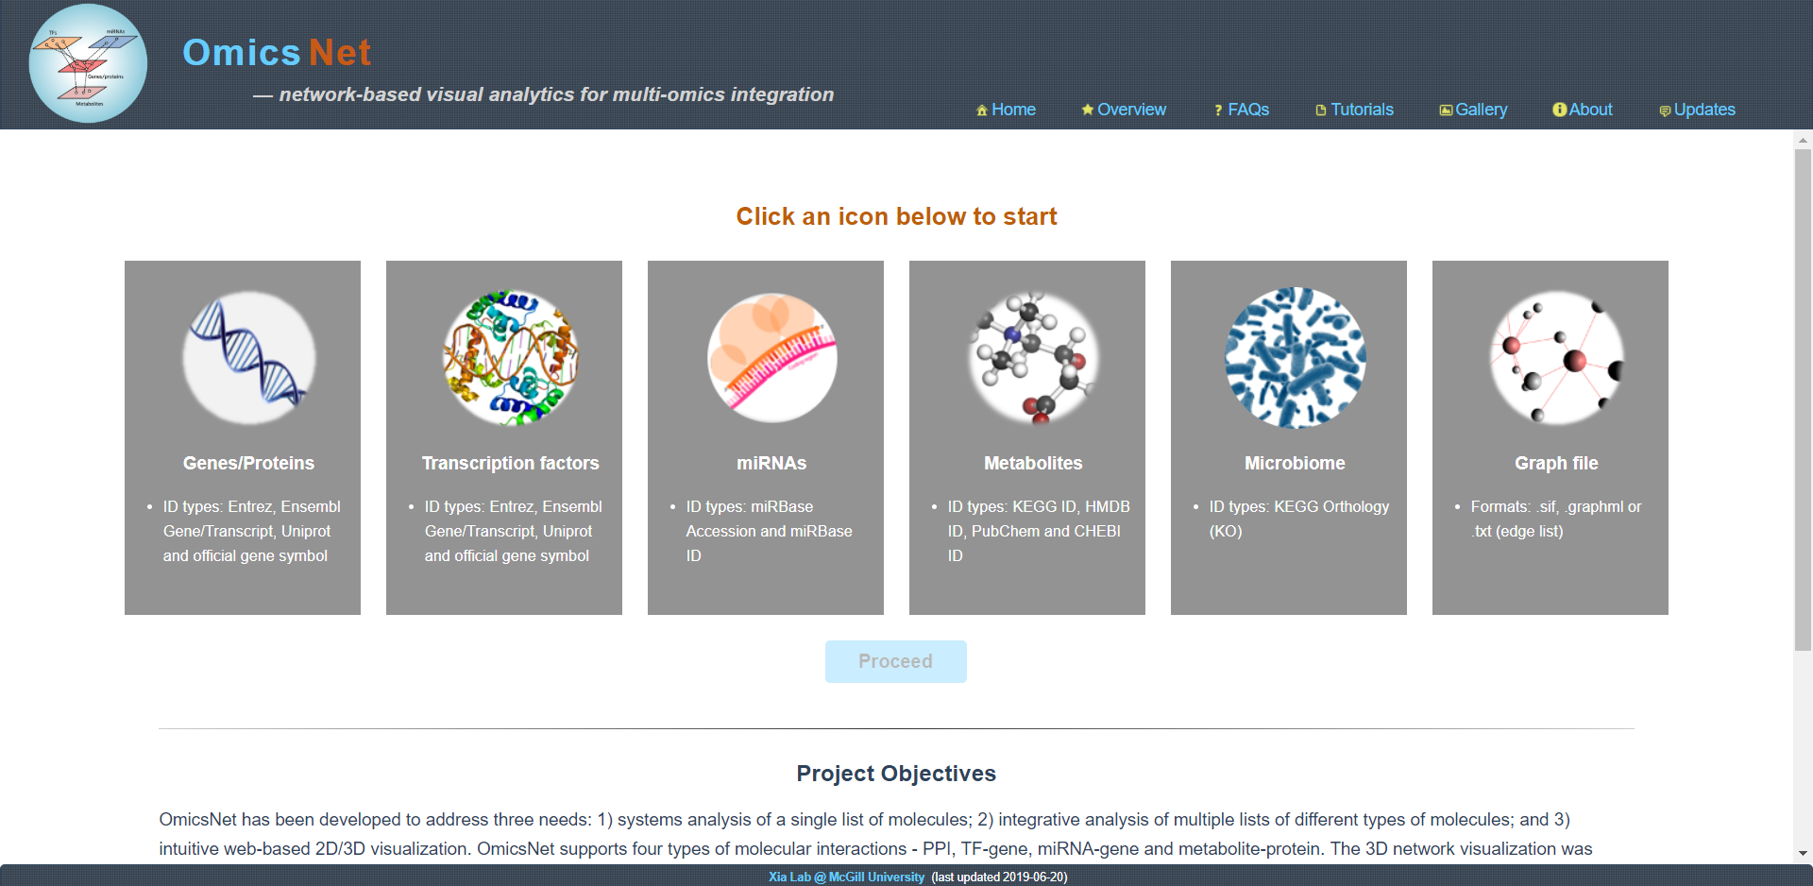
Using Excel, open the “networkanalyst_siggenes.csv” file. This file contains the results of differential expression analysis using NetworkAnalyst. The first 444 genes were significantly different between the breast cancer and healthy tissue samples.
Click the grey “Genes/proteins” rectangle.
As this data contains microarray and metabolomics data, we can visualize relationships between the most significant genes and metabolites using OmicsNet.

Slide 10
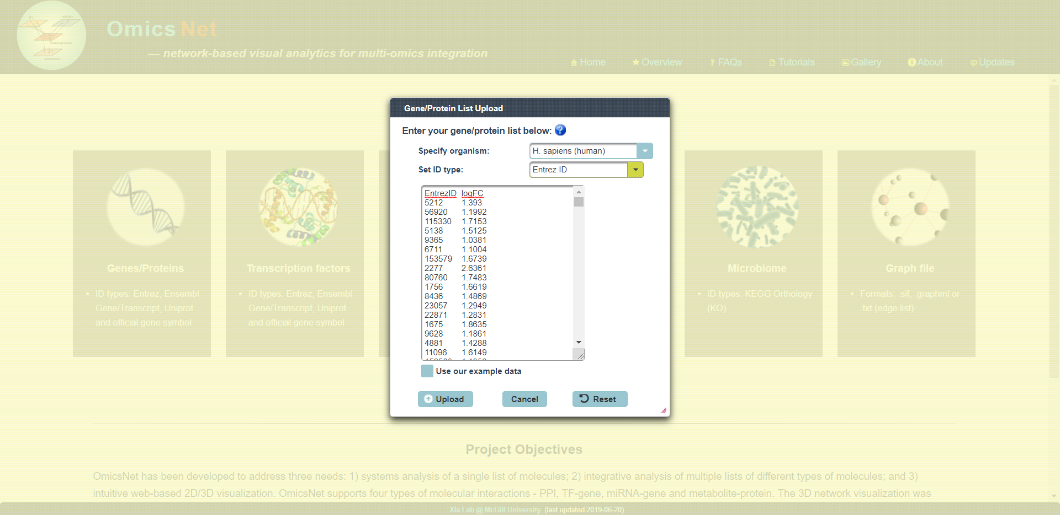
Set the Organism to “Human”, ID type to “Entrez ID” and copy the first 444 genes into the empty text box. Click “Upload” to upload the list of significant genes.

Slide 11
Using Excel, open the “metaboanalyst_t_test.csv” file. This file contains the T-test results using MetaboAnalyst.
Click the grey “Metabolites” rectangle.

Slide 12
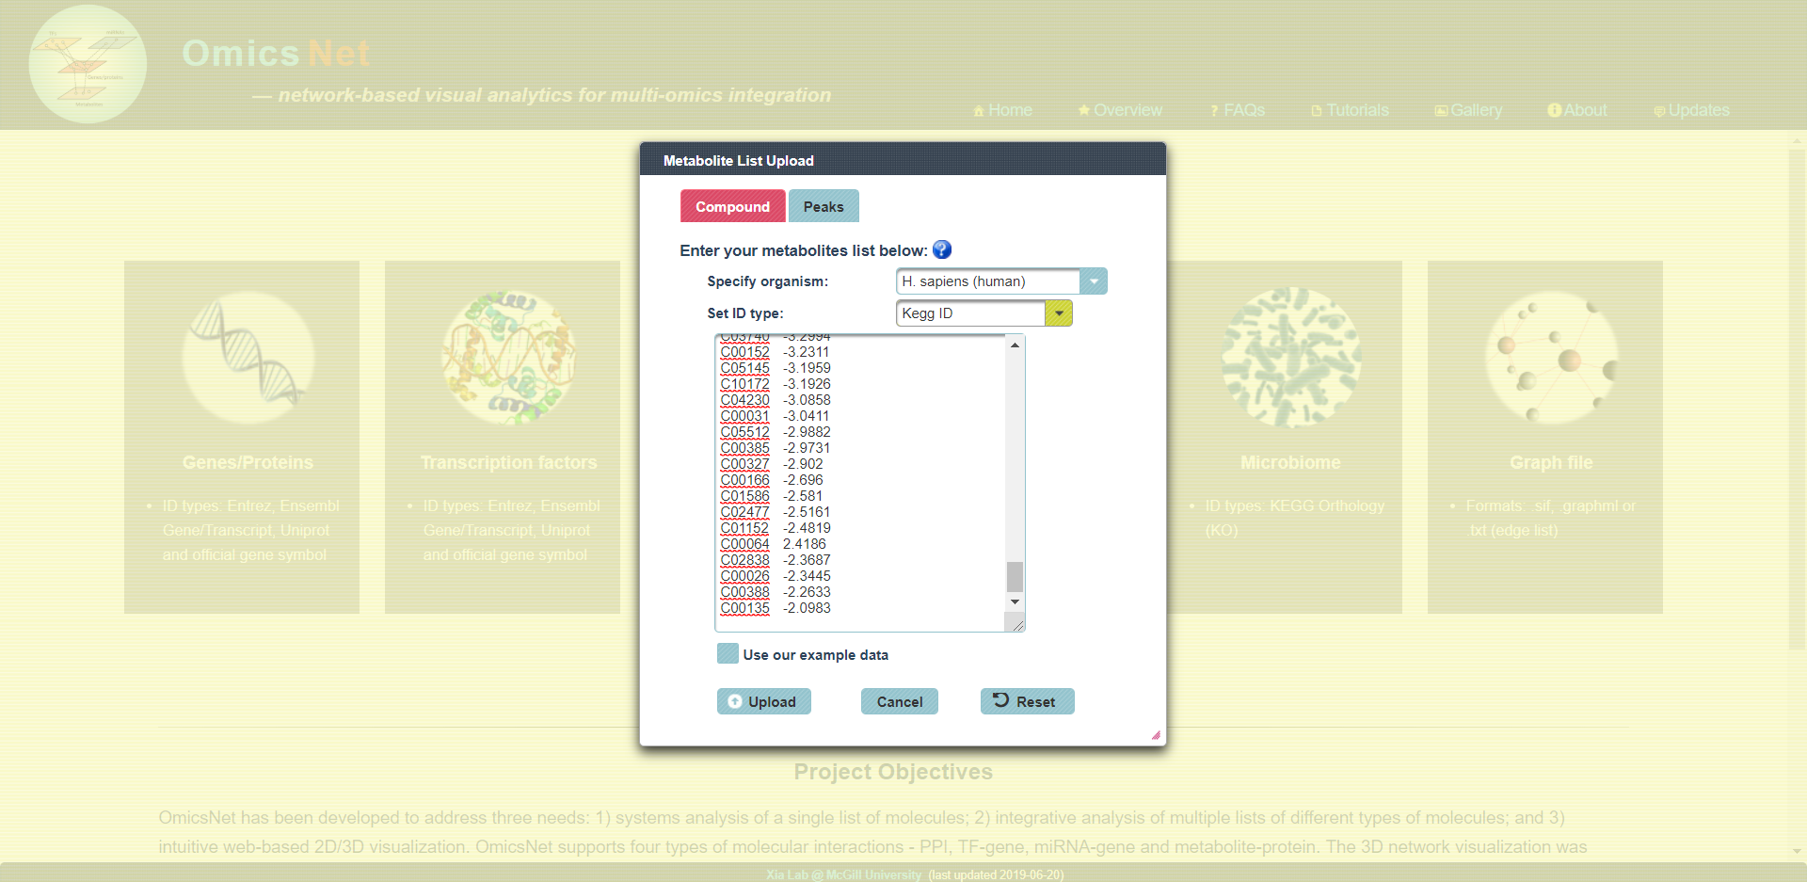
Set the Organism to “Human”, ID type to “KEGG ID” and copy all the compounds to the empty text box. Click “Upload” to upload the list of significant metabolites.
Click “Proceed” to move forward.

Slide 13
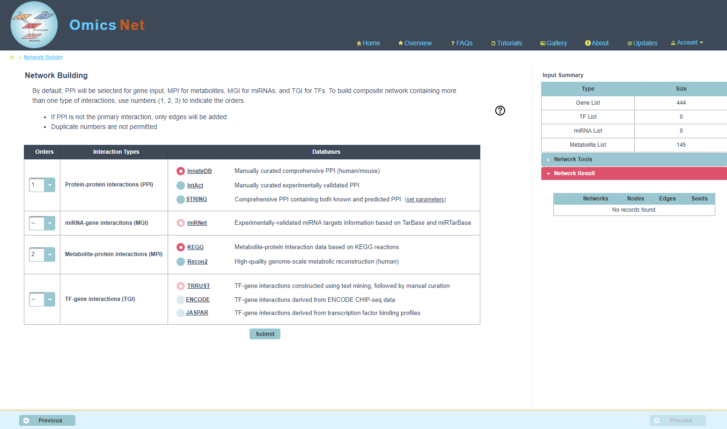
Keep the Interaction Types as default and click “Submit”.

Slide 14
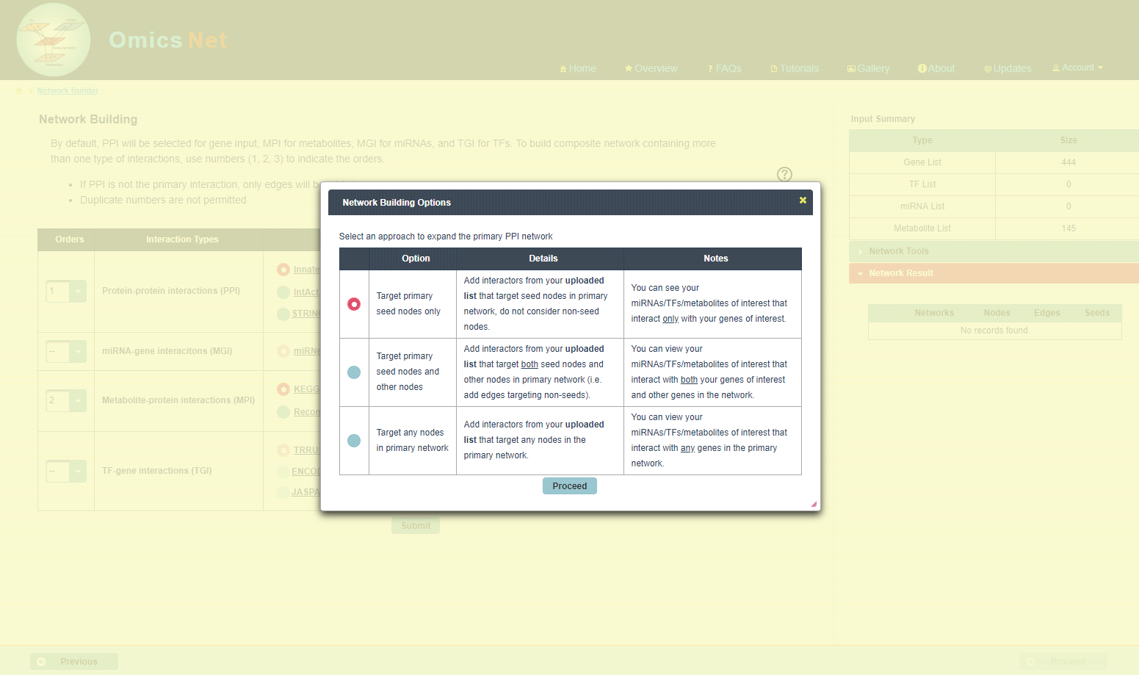
Keep the Network Building Options set to default and click “Proceed”.

Slide 15
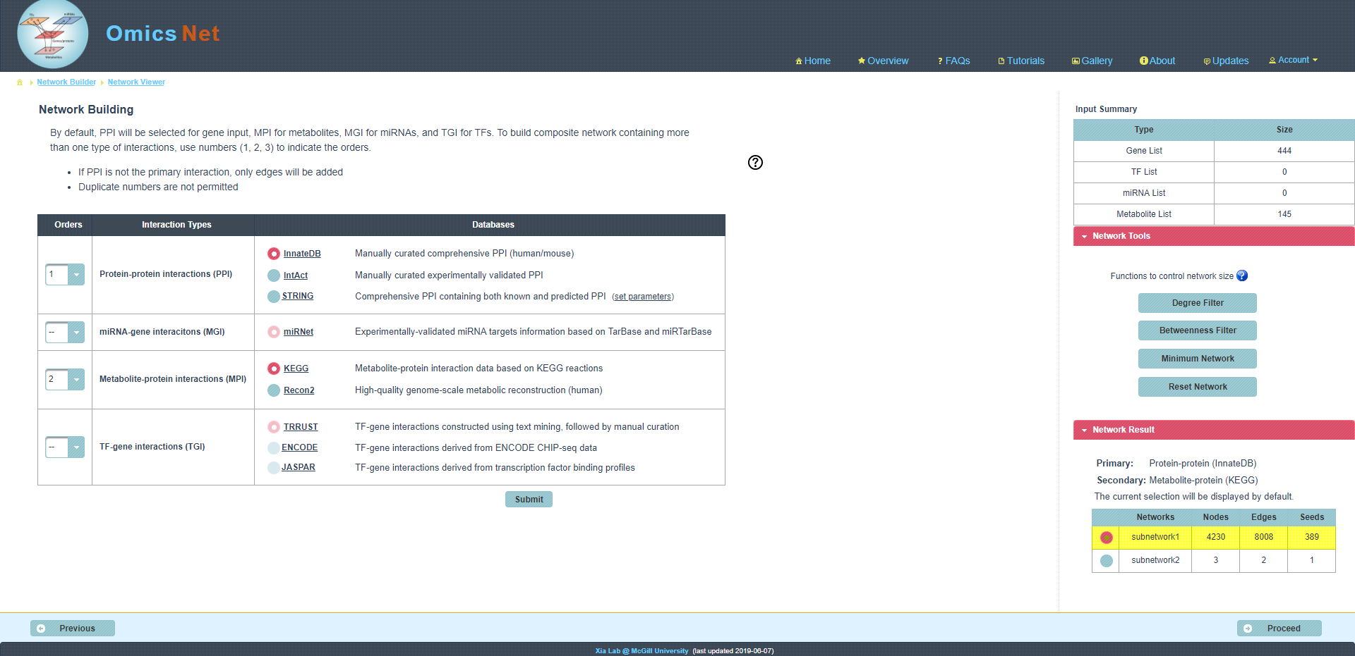
Click on “Minimum Network” to trim the current network. This function attempts to identify the smallest network connecting all seed molecules
Click on proceed after trimming

Slide 16
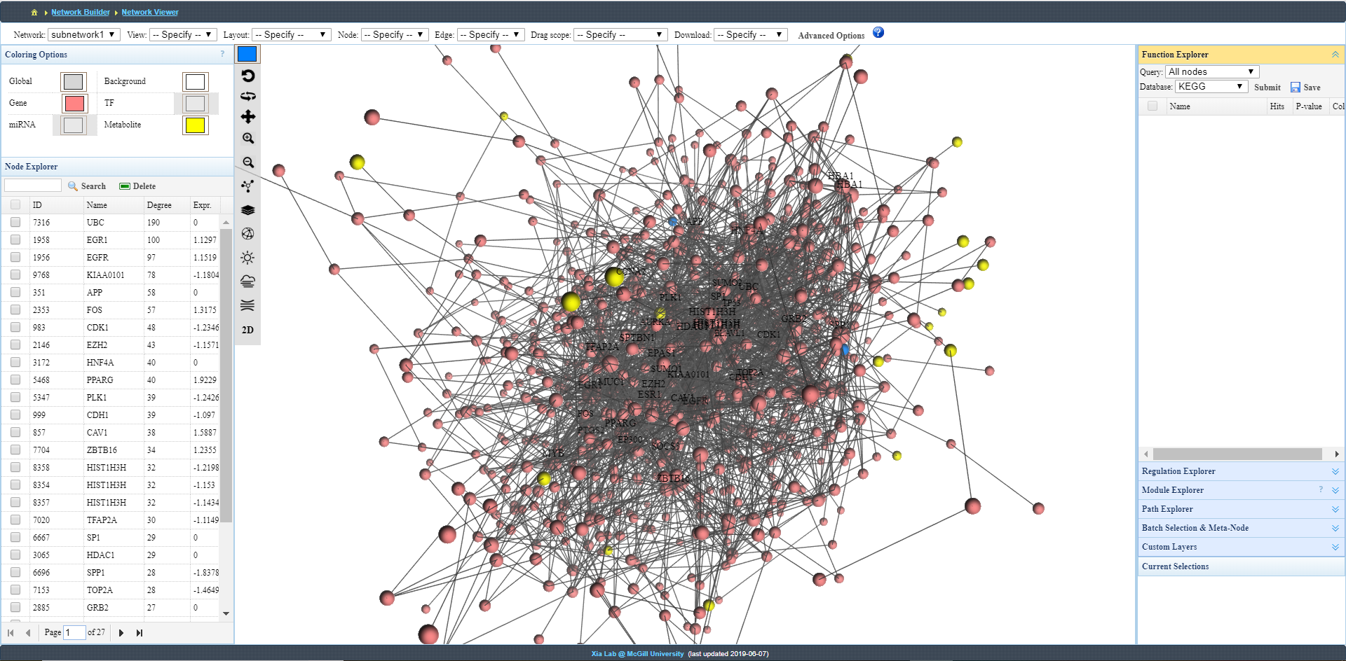
Default 3D network. Red nodes are genes and yellow nodes are metabolites.
Change edge opacity using “Opacity” drop-down option
Change the node colors using these colored boxes.

Slide 17
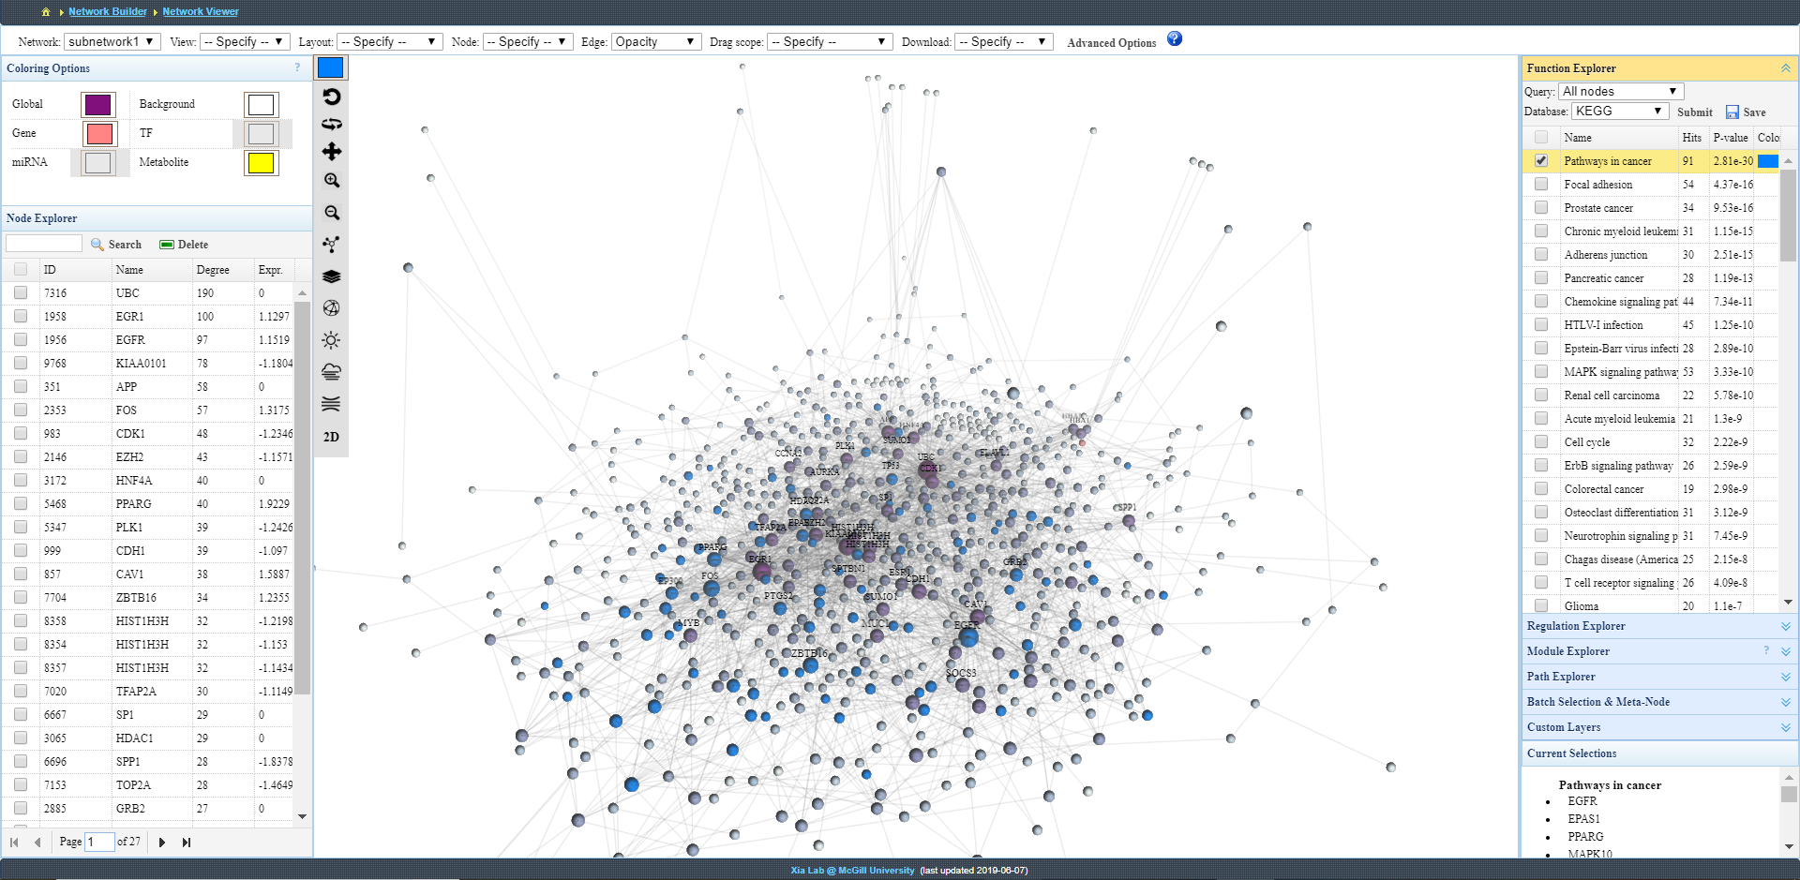
Using the top toolbar, set the layout to “Layered”. We can see that there are few metabolites included in the network.
KEGG enrichment analysis using all nodes. Explore results by choosing subsets. Many sets are linked with cancer. Choosing a pathway will highlight associated nodes in the network
Using “Global” coloring option, change node colors based on network topology (degree)

Slide 18
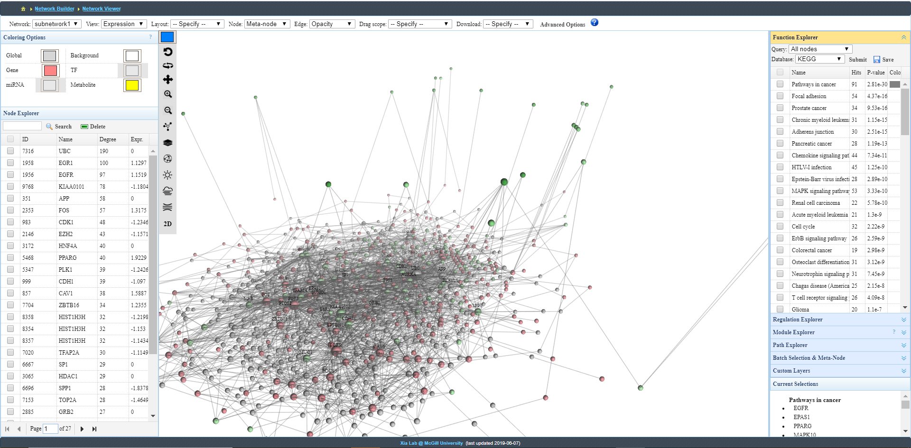
Using “View” toolbar, select “Expression” to color nodes according to their fold change. Grey nodes refer to interacting partners
Most metabolites are downregulated according to their green color.

Slide 19
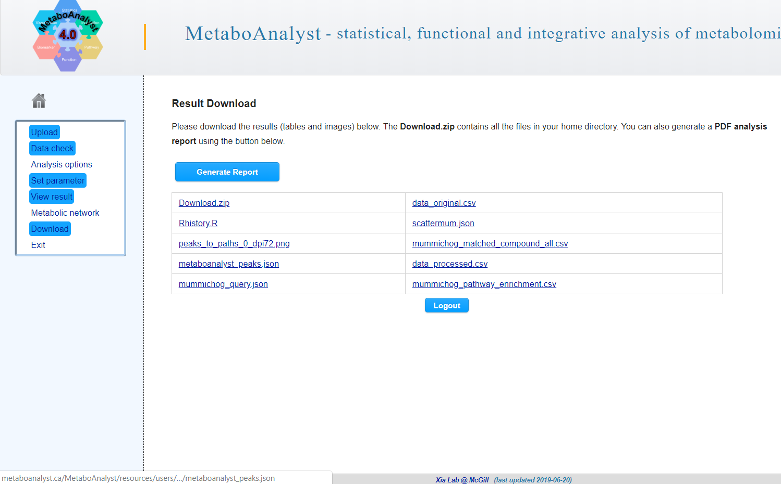
Handling MS peaks data
OmicsNet can now visualize processed peak data from untargeted metabolomics
Take input generated from “MS Peaks to Pathways” module from MetaboAnalyst.
Click on “Download” option after performing peaks-to-function analysis
Download the file called “metaboanalyst_peaks.json”

Slide 20
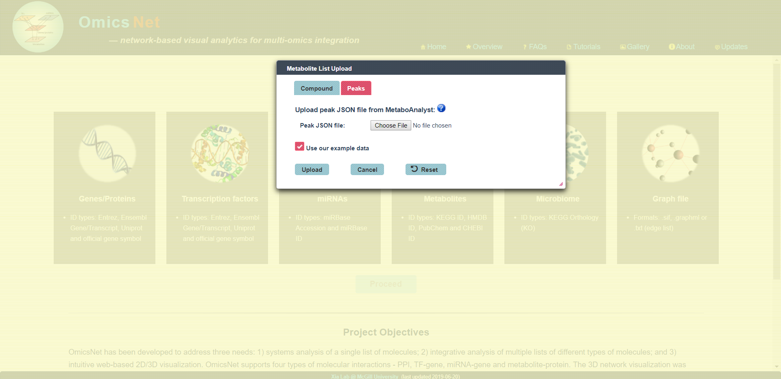
Use our example data for this showcase

Slide 21
Visualizing peaks from MetaboAnalyst
From the MetaboAnalyst-generated peak file, OmicsNet visualizes the metabolites from top 10 enriched pathways identified from MetaboAnalyst (Mummichog, GSEA or both).
Each metabolite is defined as a single or an aggregate of putative peaks, which can be visualized in the network visualization
Interaction network is build by searching against interacting enzyme in KEGG database.
PCSF/”Minimum Network” can be performed to identify context specific subnetworks

Slide 22
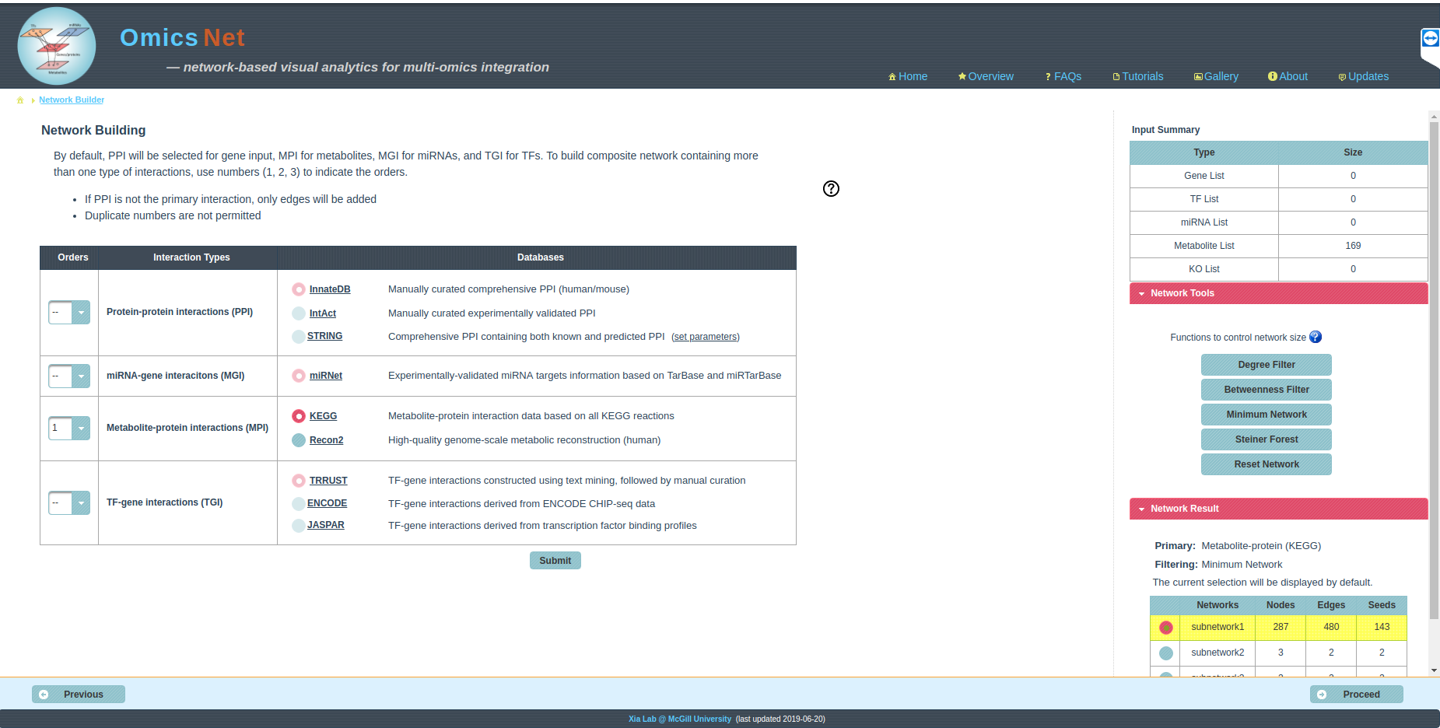
Perform “Minimum Network” algorithm

Slide 23
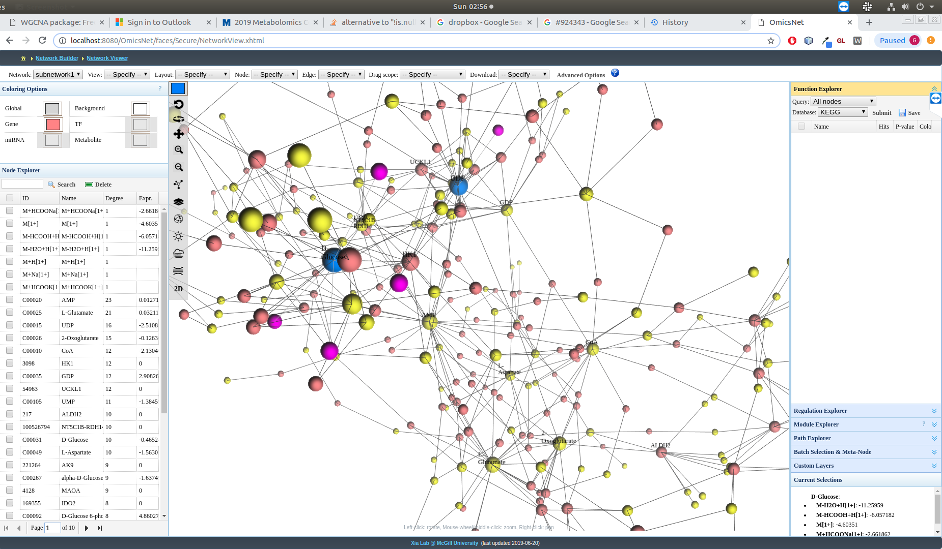
Double click on Metabolite nodes (Yellow) so that it displays the associated putative peaks.
Associated peaks are displayed here

Slide 24
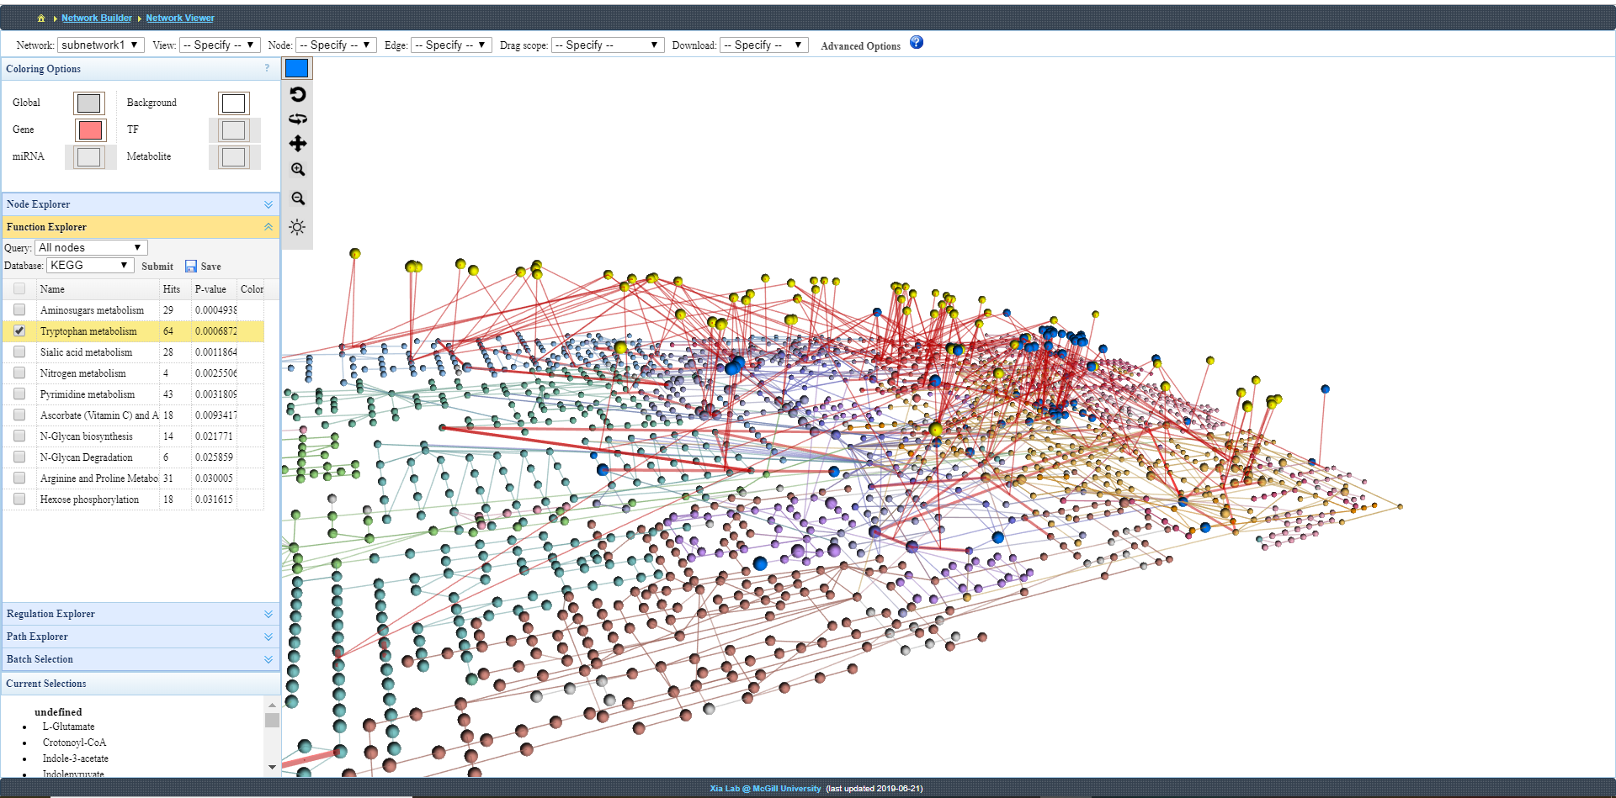
KEGG Viewer is an alternative to “First order network”. The genes and metabolites are mapped onto Global KEGG Metabolic network

Slide 25
Further exploration
Refer to the FAQs, Tutorials, and Resources page of OmicsNet for more information.
For a detailed tutorial, follow the recent Bioinformatics Protocol “Using OmicsNet for Network Integration and 3D Visualization” (https://currentprotocols.onlinelibrary.wiley.com/doi/full/10.1002/cpbi.69).

Slide 26
References
Terunuma A, Putluri N, Mishra P, Mathé EA, Dorsey TH, Yi M, Wallace TA, Issaq HJ, Zhou M, Killian JK, Stevenson HS. MYC-driven accumulation of 2-hydroxyglutarate is associated with breast cancer prognosis. The Journal of clinical investigation. 2014 Jan 2;124(1):398-412.
Zhou G, Xia J. OmicsNet: a web-based tool for creation and visual analysis of biological networks in 3D space. Nucleic acids research. 2018 Jun 7;46(W1):W514-22.

